Slide 1

Stock Market Time Series
S&P 500
Francis Odo

Slide 2
Exploratory Phase
Note: Preliminary work is currently in progress. This phase is considered exploratory. Basic layout of modeling and analysis to follow.

Slide 3
Data Time Series
Compiled stock performance data
Period – Five years

Slide 4
Type and Size of Data
Data is collected over a 5 yr. period
Comma Separated Value format (CSV)
Seven Columns of inputs / Features About 3,777 Rows

Slide 5
Features Before Preprocessing
Date (Index)
Open (Opening price)
High (Highest trading price of the day)
Low (Lowest trading price of the day)
Close (Closing price of the day)
Volume (Trading volume of the day)
Name (Ticker Symbol)

Slide 6
Why Stock Data
NonLinear
Data has ideal structure for modeling
Quantifiable Key Performance Index

Slide 7
Source of Data
Kaggle.com

Slide 8
Questions to which answers are offered
Trend
Is there an upward or downward trend?
Pattern
Is there a pattern that repeats?
Seasonality or Stationarity?

Slide 9
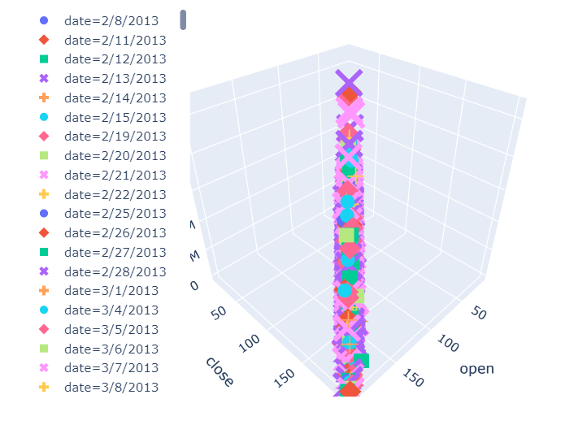
Visualization - Cluster

Slide 10
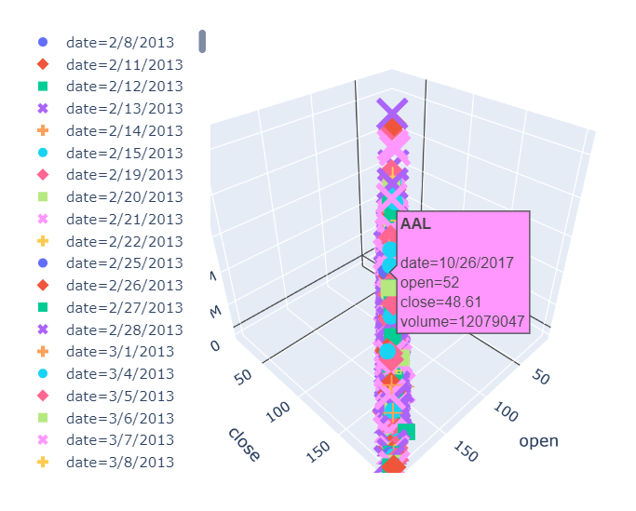
Principal Component - AAPL

Slide 11
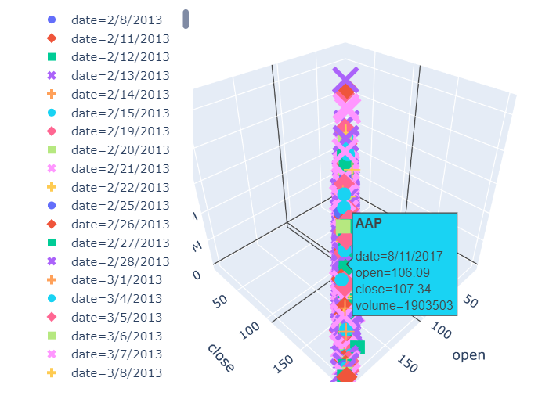
Principal Component - AAP

Slide 12
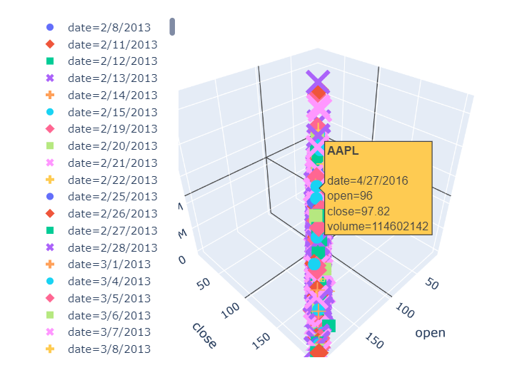
Principal Component - AAPL

Slide 13
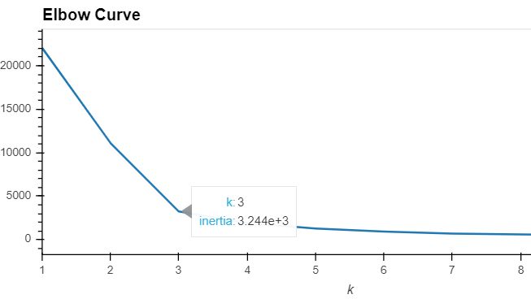
KMeans - Elbow Curve K=3

Slide 14
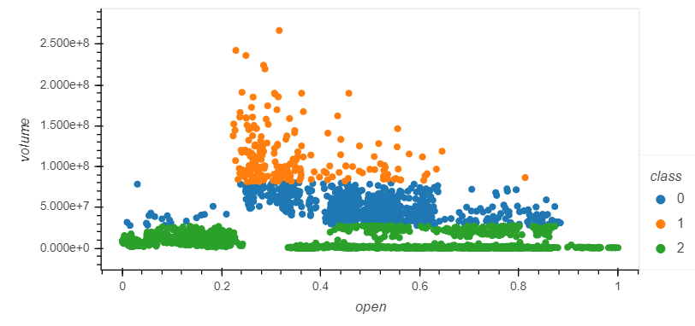
Cluster - Classification

Slide 15
Database Integration
Jupyter Notebook
Postgres SQL DB

Slide 16
Machine Learning Model
Supervised Learning
Classification
Prediction

